Slide 1




HackOrbit 2025
YeAhML

Slide 2

THEME & PROBLEM STATEMENT
THEME – AI, LLMs, RAG
Any debate, any argument. People make absurd claims. How do you check if they are correct?
Chatgpt?
It gives you answers from any source.
It hallucinates over few questions.
Few Google searches?
Good luck with it…
How accurate will it be, and how long will it take?
You definitely need something that can... verify with real evidence, and tell you clearly if a claim is legit or not— no guessing.

Slide 3
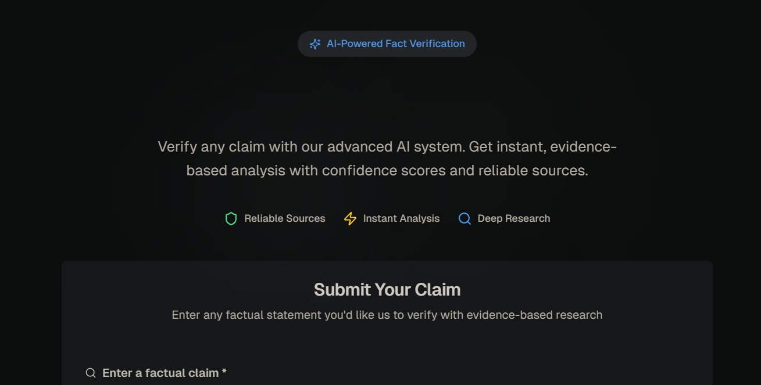

PROPOSED SOLUTION Sample UI (below)
So, we will build exactly that. A tool that takes any claim, looks at actual sources, and tells you:
✅ Is it supported?
❌ Is it false?
Is there not enough evidence?
It breaks it down for you — with a short verdict, an explanation, and the exact lines from the source.
No hallucinations. No endless Googling. Just fact-checking, simplified.
Tech Stack
AI Models: GPT-4 / LLaMA / Mistral (via OpenAI or Hugging Face)
Backend: Python (FastAPI/Flask), dotenv, requests
Frontend: React + Tailwind (clean UI via v0.dev-like layout)
Infra: Local/dev mode for now; future-ready for API & web scraping integration

Slide 4
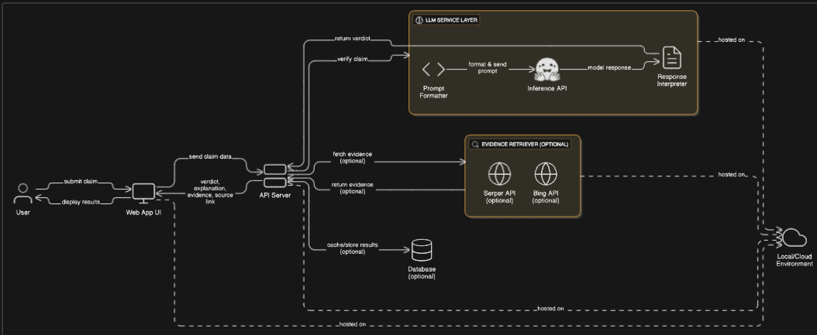
FLOWCHART / DIAGRAM

Slide 5
FLOWCHART / DIAGRAM Explanation
1. Frontend (UI)
A simple web app where users can:
Enter a claim.
Optionally paste supporting evidence or choose to let the app find it.
View the result: verdict, explanation, source summary, and claim check score.
2. Backend (API Server)
The central controller of the system.
Accepts claims from the frontend and manages the flow of data.
Prepares prompts for the LLM, sends them out, and receives structured responses.
Parses and returns verdicts in a user-friendly format.
3. LLM Service Layer
Integrates with APIs like Hugging Face Inference (e.g., Mistral, LLaMA).
Sends a prompt containing the claim and evidence to the model.
The model replies in structured JSON: verdict + reasoning.
Ensures hallucination is minimized by tightly controlling prompt design and evidence flow.
4. Evidence Retriever (Optional Advanced)
If no evidence is given by the user, this module:
Searches the web using APIs like Serper.dev, Bing Web Search, or custom scrapers.
Extracts snippets or articles relevant to the claim.
Feeds this into the LLM to back up or refute the claim.
5. Database (Optional)
Stores:
Claims and results (for caching, so the same claim doesn't hit the LLM again).
User queries (for analytics).
Enables usage metrics and future dashboards.
6. Environment
LLM calls use Hugging Face's hosted inference API (or similar endpoints).
Backend runs locally, or in cloud (like Render, Vercel, etc.).
Scalable and modular—each part can be swapped based on usage, budget, or upgrades.

Slide 6
FEATURES AND NOVELTY
1. Natural Language Claim Verification
Users can input any statement or argument, and the system returns a structured verdict:
✅ Supported
❌ Refuted
⚪ Neutral
L. LLM-Powered Verdicts in JSON Format
Ensures machine-readability and clean integration into dashboards or pipelines.
Each response includes:
A verdict
A concise explanation
Extracted text from source
3. Claim Check Score
Adds a confidence score based on model agreement and evidence strength.
Useful for ranking multiple claims or filtering vague ones.

Slide 7
DRAWBACK AND SHOWSTOPPERS
🔸 Dependency on LLM Accuracy
While large language models are powerful, they are not infallible. Even with evidence, models may occasionally misinterpret context or provide oversimplified explanations.
🔸 Quality of Evidence Matters
The system is only as good as the evidence it uses. If irrelevant, biased, or poor-quality sources are used, the verdict can be misleading. Auto-sourced evidence (via search APIs) might miss nuance or return unreliable data.
🔸 Access Restrictions to Certain Models
Models like GPT-4, Claude, or LLaMA may have usage restrictions, requiring:
API keys
Organization verification
Deployment on high-end hardware (for local LLMs)

Slide 8
YeAhML
Adars Balachandar
9360249476
Rohaan SS
9043096946

Slide 9
Thank you

